Slide 1
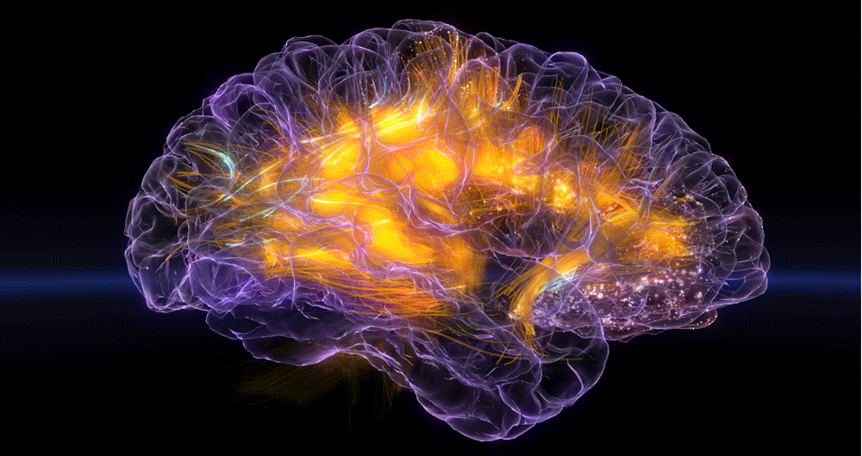
WEBSITE FOR EEG DATA VISUALIZATION TO DETECT ADHD

Slide 2
BASIC QUESTION : What Is ADHD ?
ADHD stands for attention deficit hyperactivity disorder. It is a medical condition or a mental illness. A person with ADHD has differences in brain development and brain activity that affect attention, the ability to sit still, and self-control. ADHD can affect a child at school, at home, and in friendships.
ADHD often begins in childhood and can persist into adulthood. It may contribute to low self-esteem, troubled relationships and difficulty at school or work.
Symptoms include limited attention and hyperactivity.
Treatments include medication, talk therapy and Counselling

Slide 3
Who does it affect?
About 4% of adults experience some or all ADHD symptoms.
It affects men and women almost equally.
What causes ADHD?
Researchers aren’t sure what causes ADHD. Like other mental illnesses, it’s likely caused or influenced by many different things. Examples include your genes, the environment you live in, and your life experiences.

Slide 4
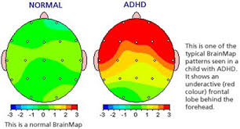
Biofeedback
Biofeedback is an alternative therapy some people use to treat the symptoms of attention-deficit hyperactivity disorder ( ADHD ).
It's also called neurofeedback, EEG biofeedback or neurotherapy. This treatment has been used since the late 1960s.

Slide 5
How does it help ?
By recording brain wave activity, a practitioner can gather information about why an individual may be having clinical symptoms based on what is happening in their brain.
States of neurophysiological over-arousal or under-arousal can contribute to why a client may be manifesting symptoms of anxiety, depression, obsessive compulsive disorder (OCD), attention deficit disorder (ADD), and a variety of other stressful conditions.(ADHD in our case)
Once initial information has been gathered, neurofeedback can be used to track brain wave activity, and train the brain to operate more efficiently by providing visual and auditory feedback to the client as their brain wave patterns improve and self-regulation occurs.

Slide 6
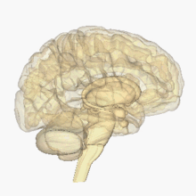
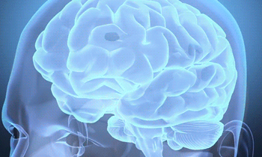
What is an EEG?
An EEG is a scalp recording of brain wave activity.
An electroencephalogram (EEG) is a test used to
evaluate the electrical activity in the brain.
Brain cells communicate with each other through
electrical impulses. (uh·lek·trow·uhn·seh·fuh·luh·gram)
An EEG can be used to help detect potential problems associated with this activity.

Slide 7
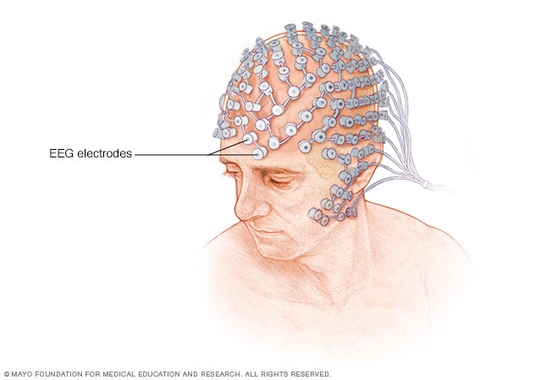
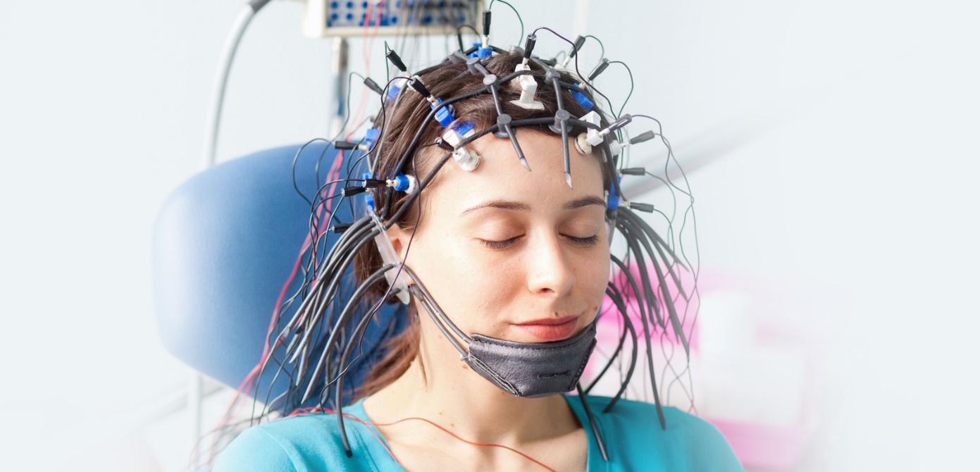
The human brain emits electrical activity in waves that can be measured by a device called an electroencephalograph
An EEG tracks and records brain wave patterns. Small flat metal discs called electrodes are attached to the scalp with wires. The electrodes analyze the electrical impulses in the brain and send signals to a computer that records the results.

Slide 8
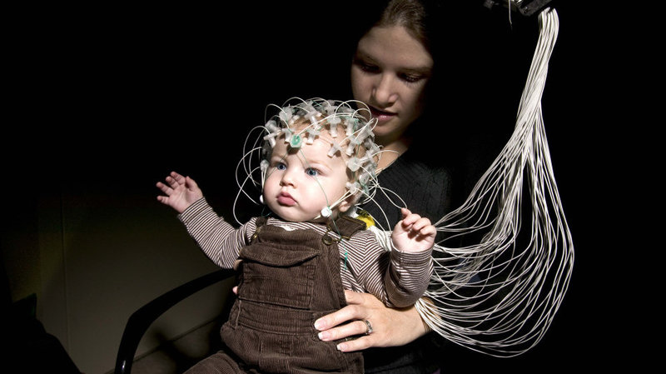
Are there risks associated with an EEG?
There are no risks associated with an EEG. The test is painless and safe.
The test causes no discomfort. The electrodes record activity. They do not produce any sensation.
In addition, there is no risk of
getting an electric shock.

Slide 9
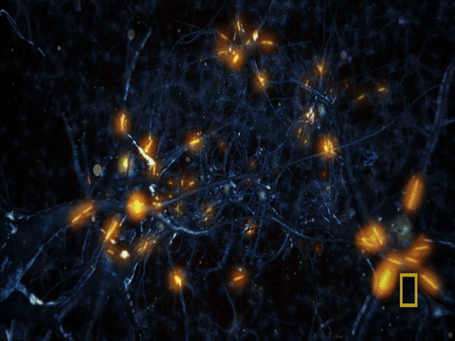
1. Montages
• Electrodes
• Channels
Electrodes and Channels

Slide 10
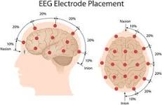
The scalp EEG signals can be recorded by different modes such as unipolar and bipolar modes.
The Figure shows the 10–20 EEG electrode positions for the placement of electrodes from the left and the top of the head.
These electrodes (channels) show the activities of different brain areas.

Slide 11
THE EEG SIGNAL
Delta – 1-3Hz
Theta – 4-7Hz
Alpha – 8-13Hz
Beta – >13Hz

Slide 12
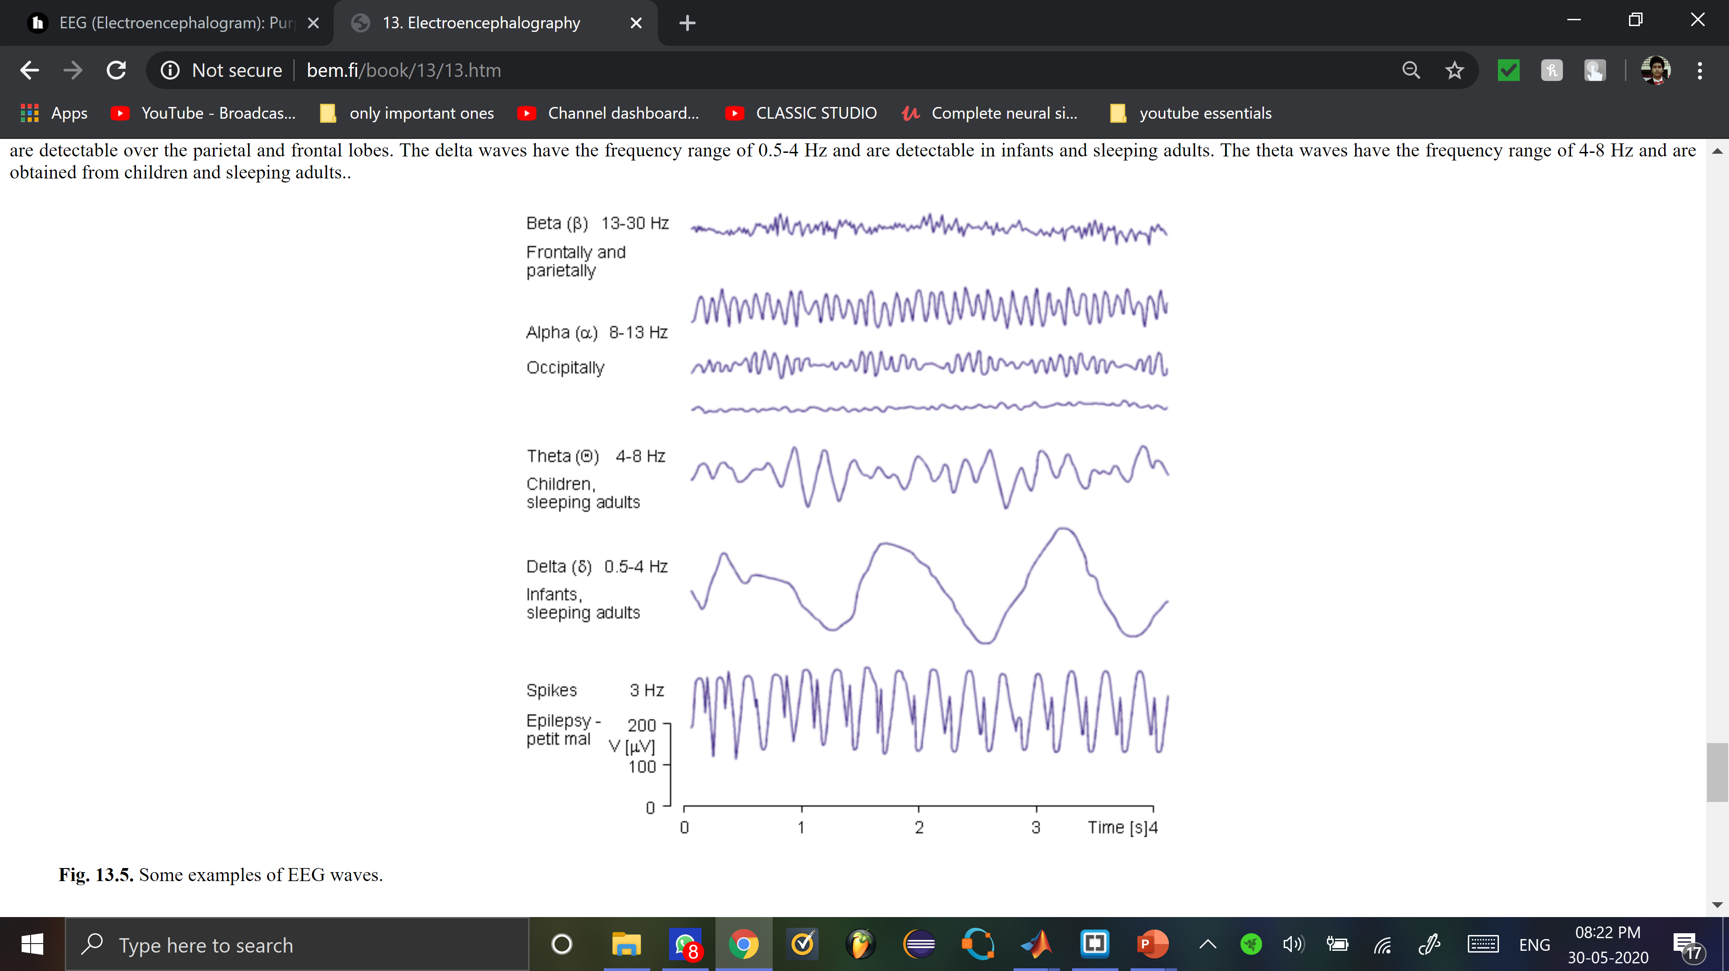
The alpha waves have the frequency spectrum of 8-13 Hz and can be measured from the occipital region in an awake person when the eyes are closed. The frequency band of the beta waves is 13-30 Hz; these are detectable over the parietal and frontal lobes. The delta waves have the frequency range of 0.5-4 Hz and are detectable in infants and sleeping adults. The theta waves have the frequency range of 4-8 Hz and are obtained from children and sleeping adults.
Alpha ( α )

Slide 13
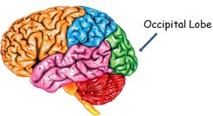
LOCATION OF THE OCCIPITAL LOBE IN YOUR BRAIN

Slide 14
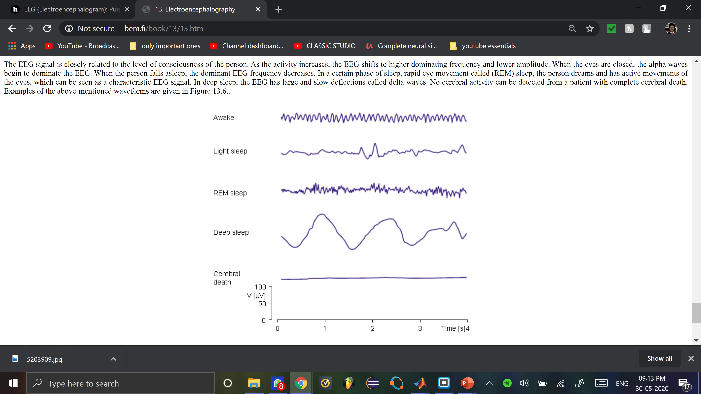
THE BASIC PRINCIPLES OF EEG DIAGNOSIS
The EEG signal is closely related to the level of consciousness of the person. When the eyes are closed, the alpha waves begin to dominate the EEG. When the person falls asleep, the dominant EEG frequency decreases. In a certain phase of sleep, rapid eye movement called (REM) sleep, the person dreams and has active movements of the eyes, which can be seen as a characteristic EEG signal. In deep sleep, the EEG has large and slow deflections called delta waves. No cerebral activity can be detected from a patient with complete cerebral death.

Slide 15
WEBSITE

Slide 16


Slide 17


Slide 18
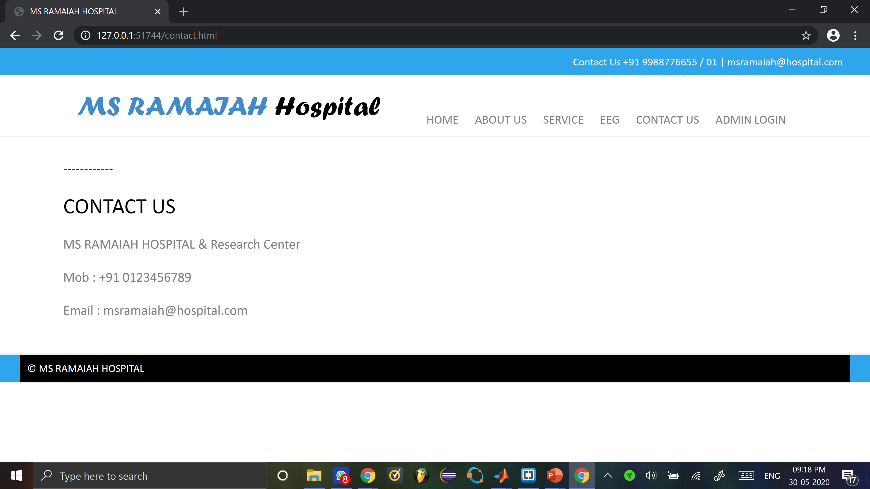

Slide 19
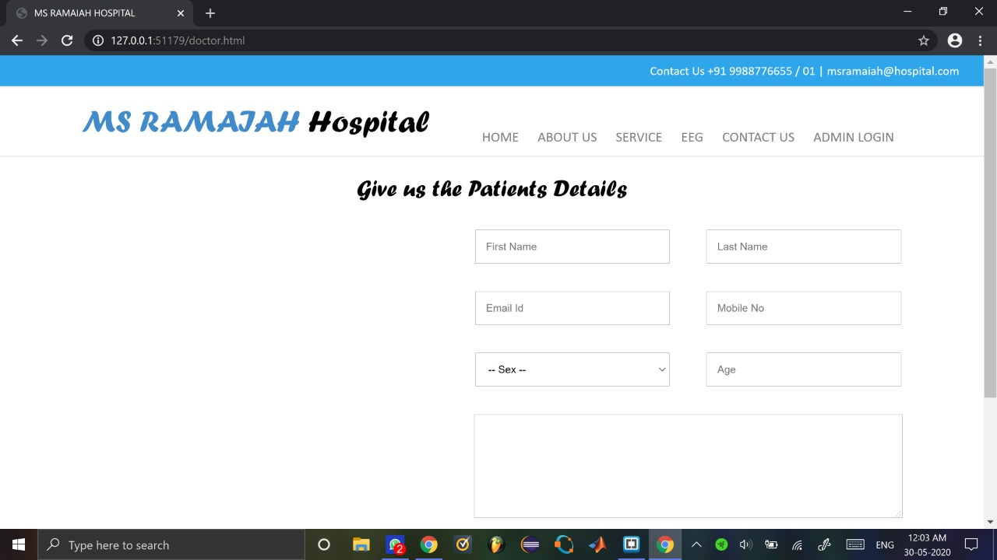

Slide 20
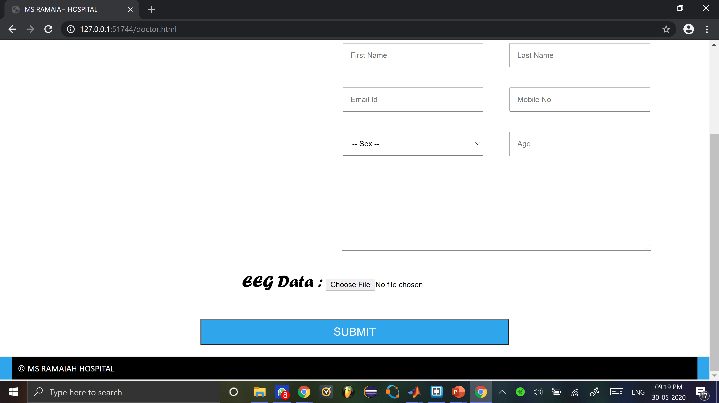

Slide 21
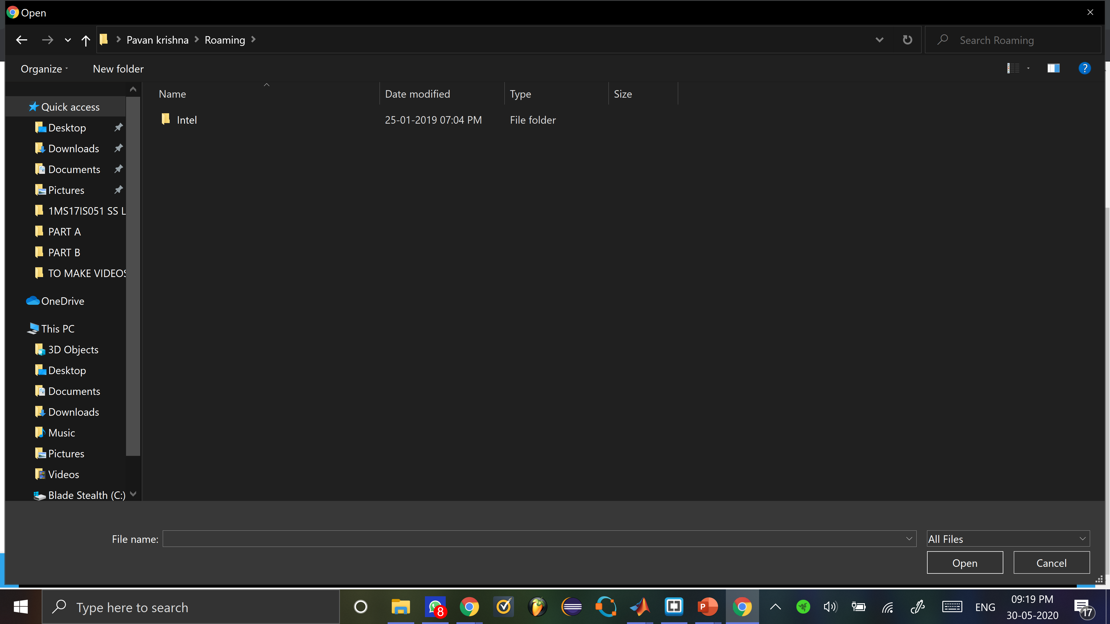

Slide 22
How the EEG data is analysed by us
First we convert the data to double-precision
We then apply the Fourier transform to the whole data Any periodic waveform can be produced by adding up a series of sin waves of the appropriate frequency and amplitude. The FFT looks at a complex waveform and calculates those frequencies and amplitudes. The result is a new curve which plots amplitude vs frequency.
Then we average the power from 8-12 Hz (the "alpha band") and make a topographical map of the distribution of this power.
We then quantify this part . i.e. square it, to get amplitude and better peaks which can be easily viewed
Then we plot the spectrum of all channel data on the scalp
Physically analyse the image and draw a conclusion

Slide 23
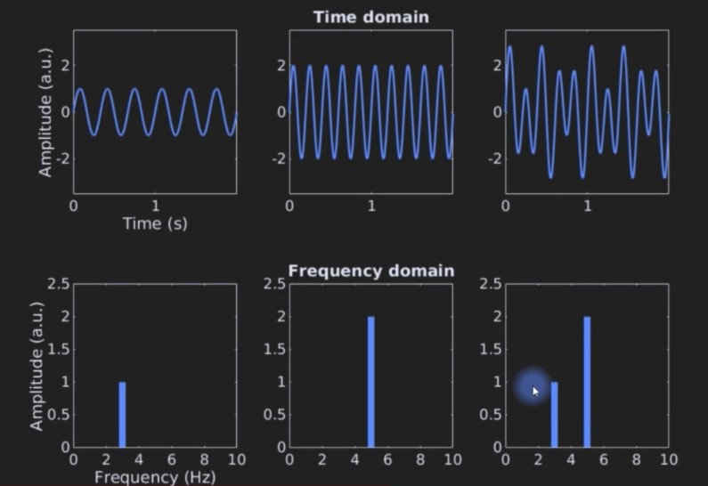
The EEG data recorded is in time domain. We convert the data in frequency domain because it can improve signal to noise characteristics in interpreting the signal.

Slide 24
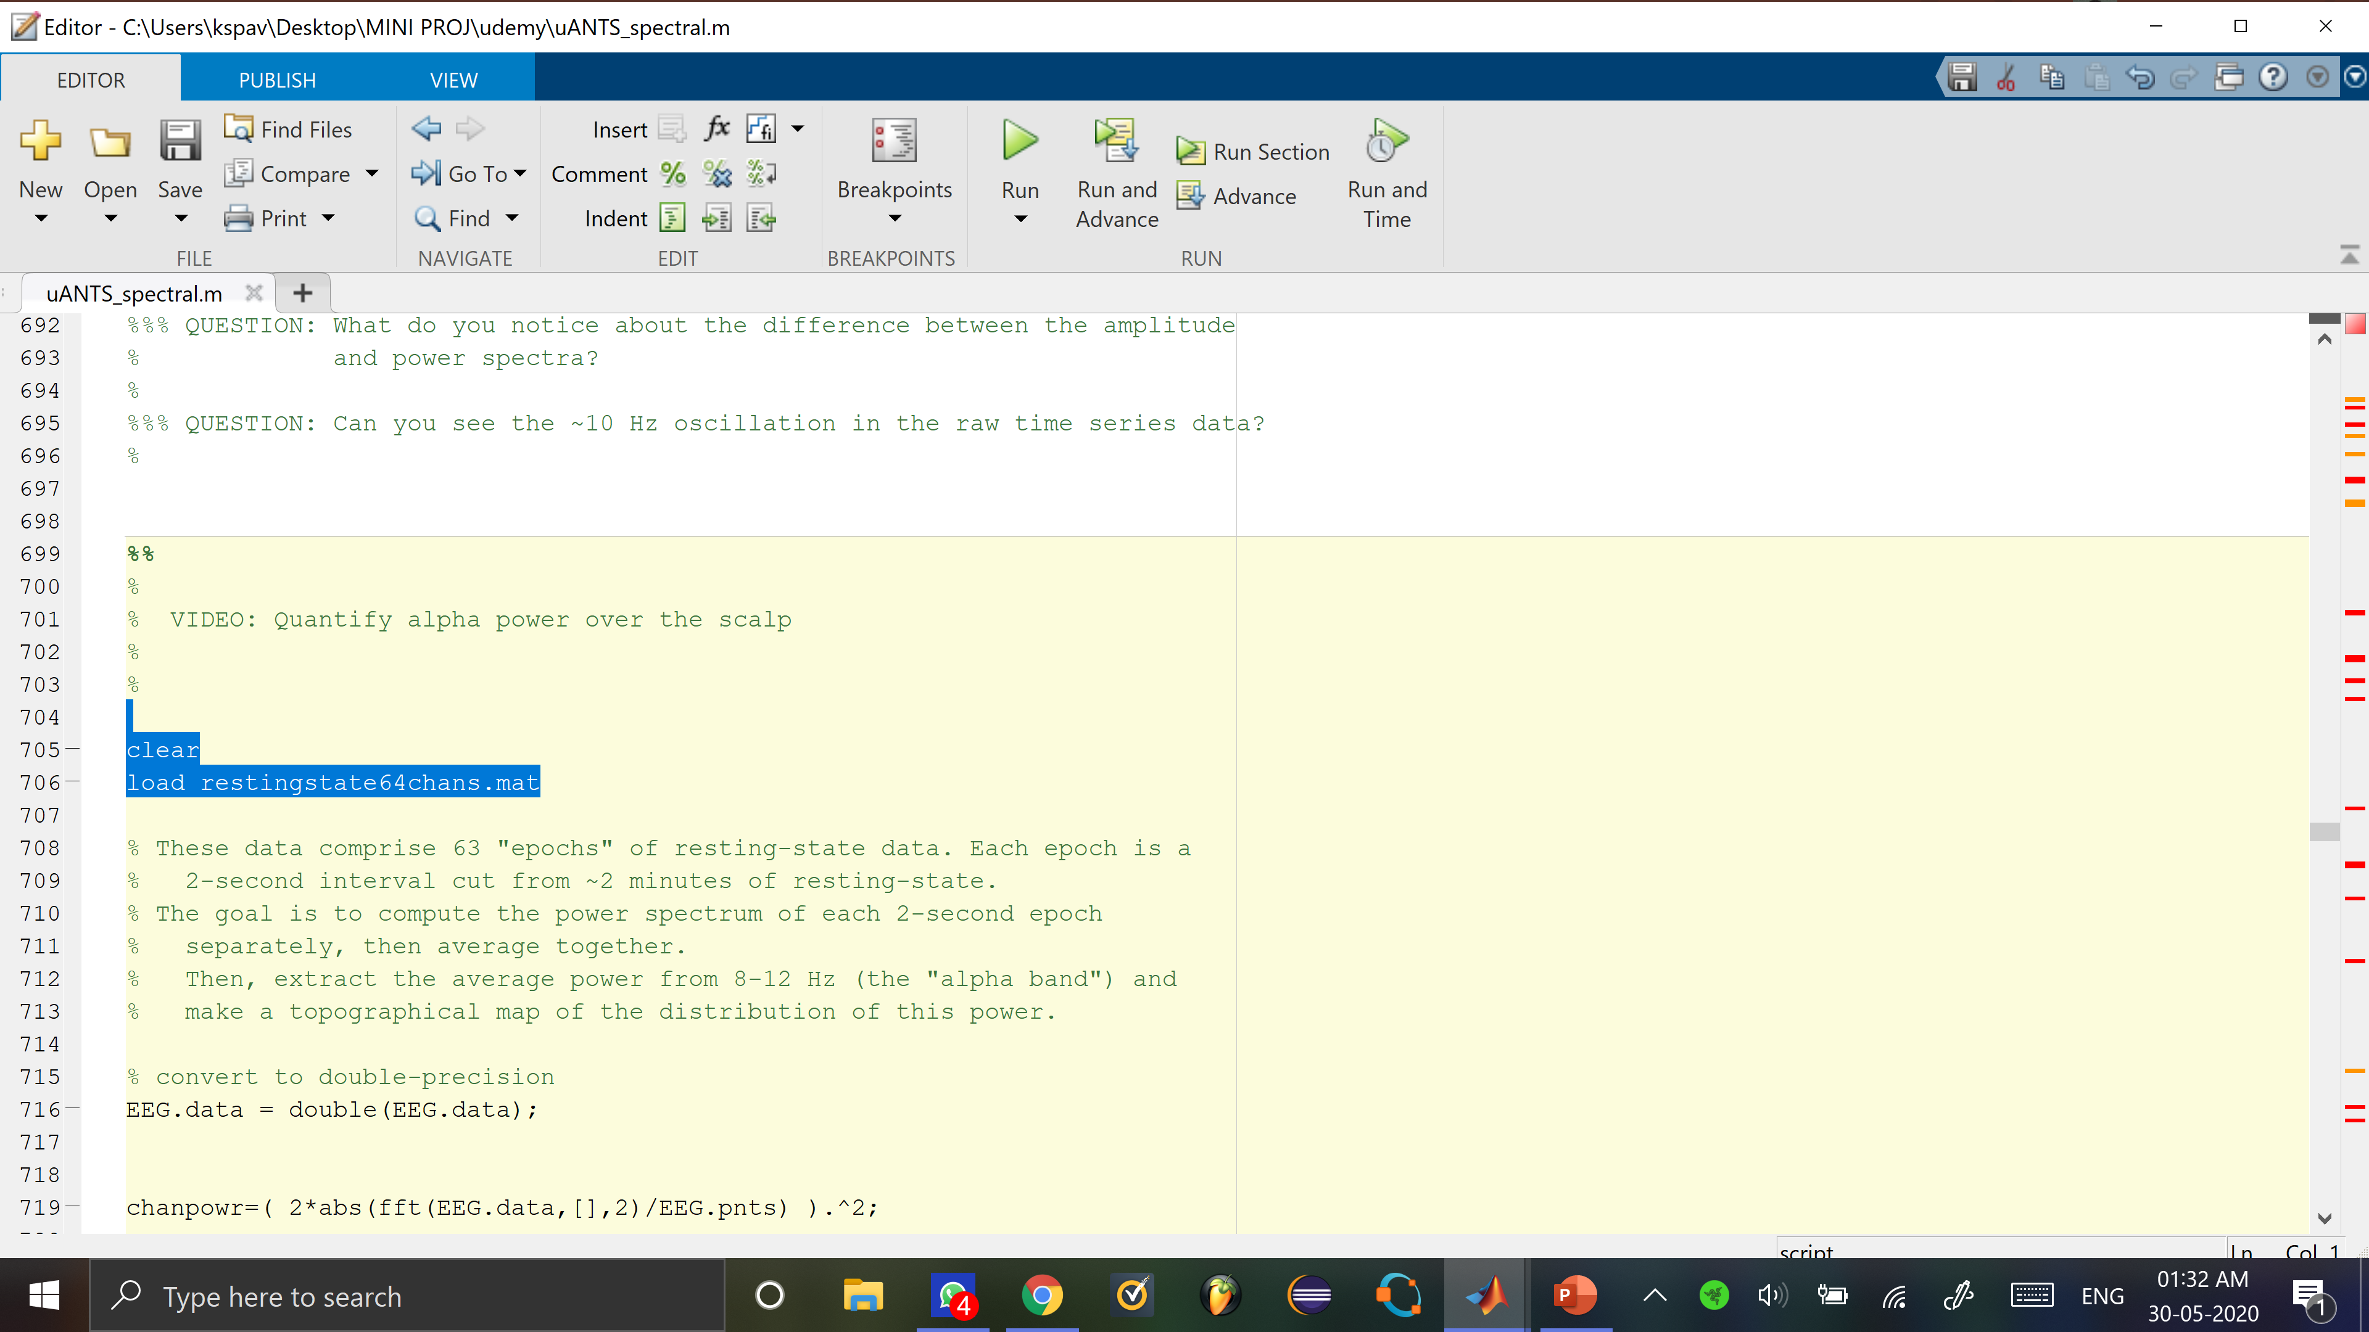
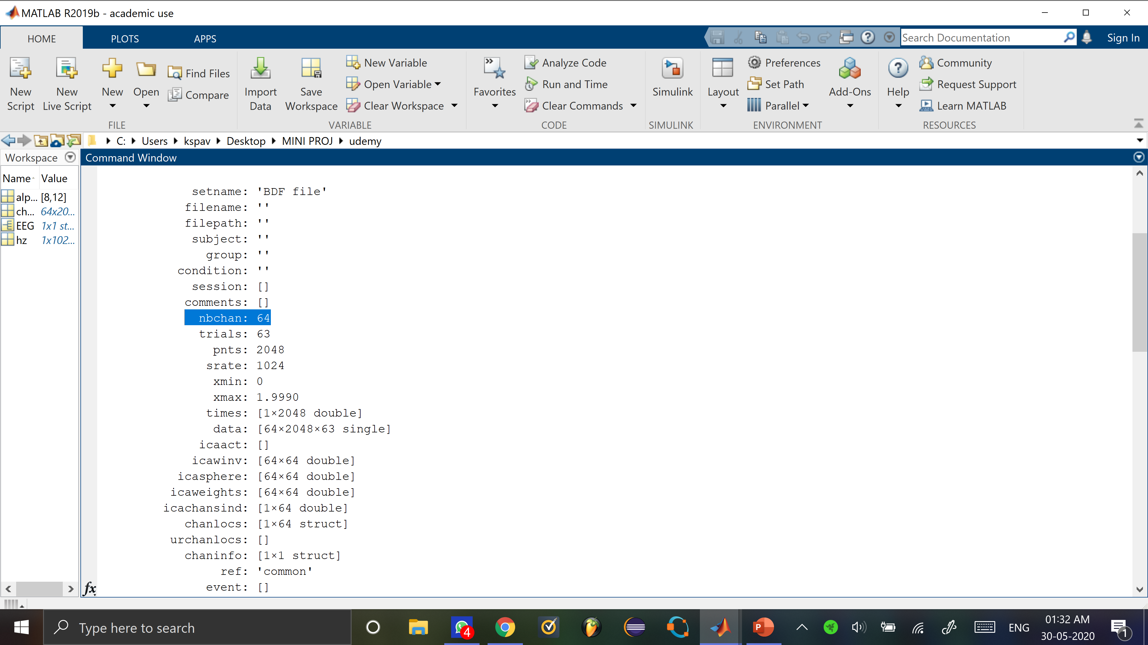
64 CHANNELS
Loading The Dataset

Slide 25
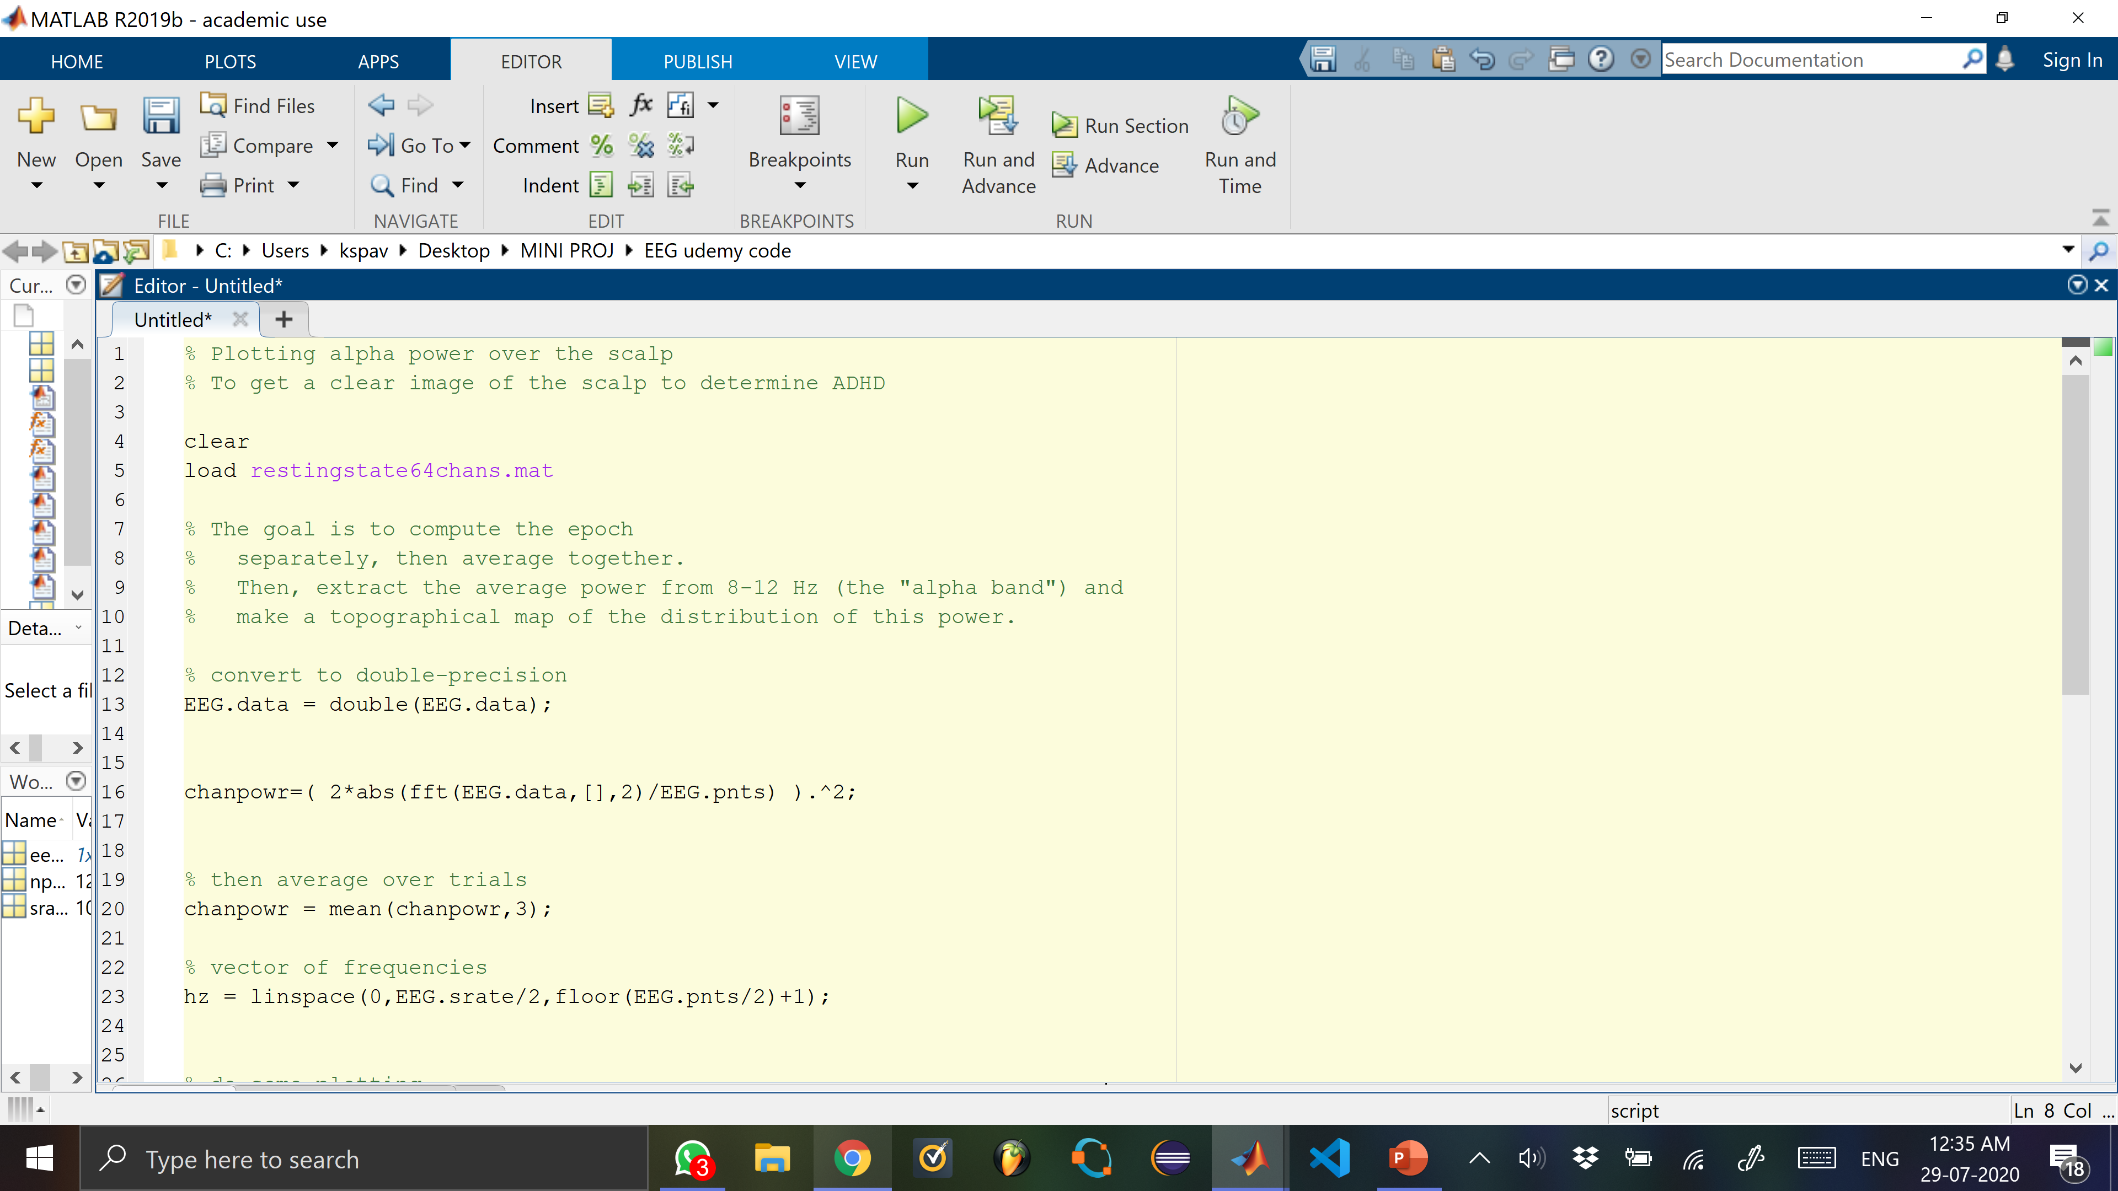

Slide 26
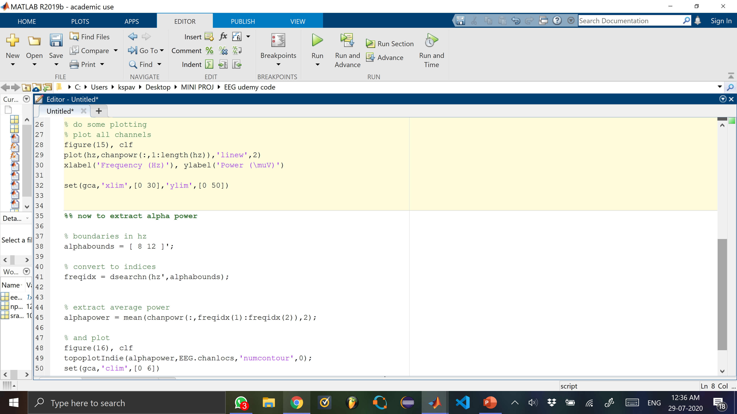

Slide 27
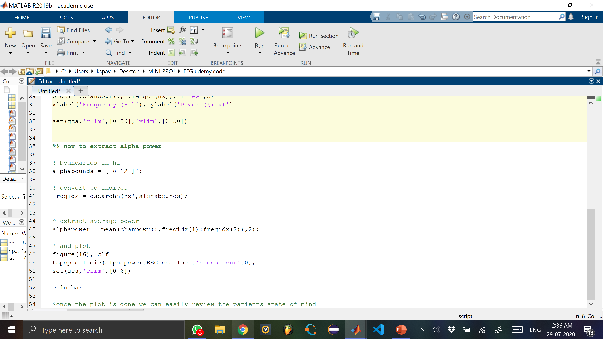

Slide 28
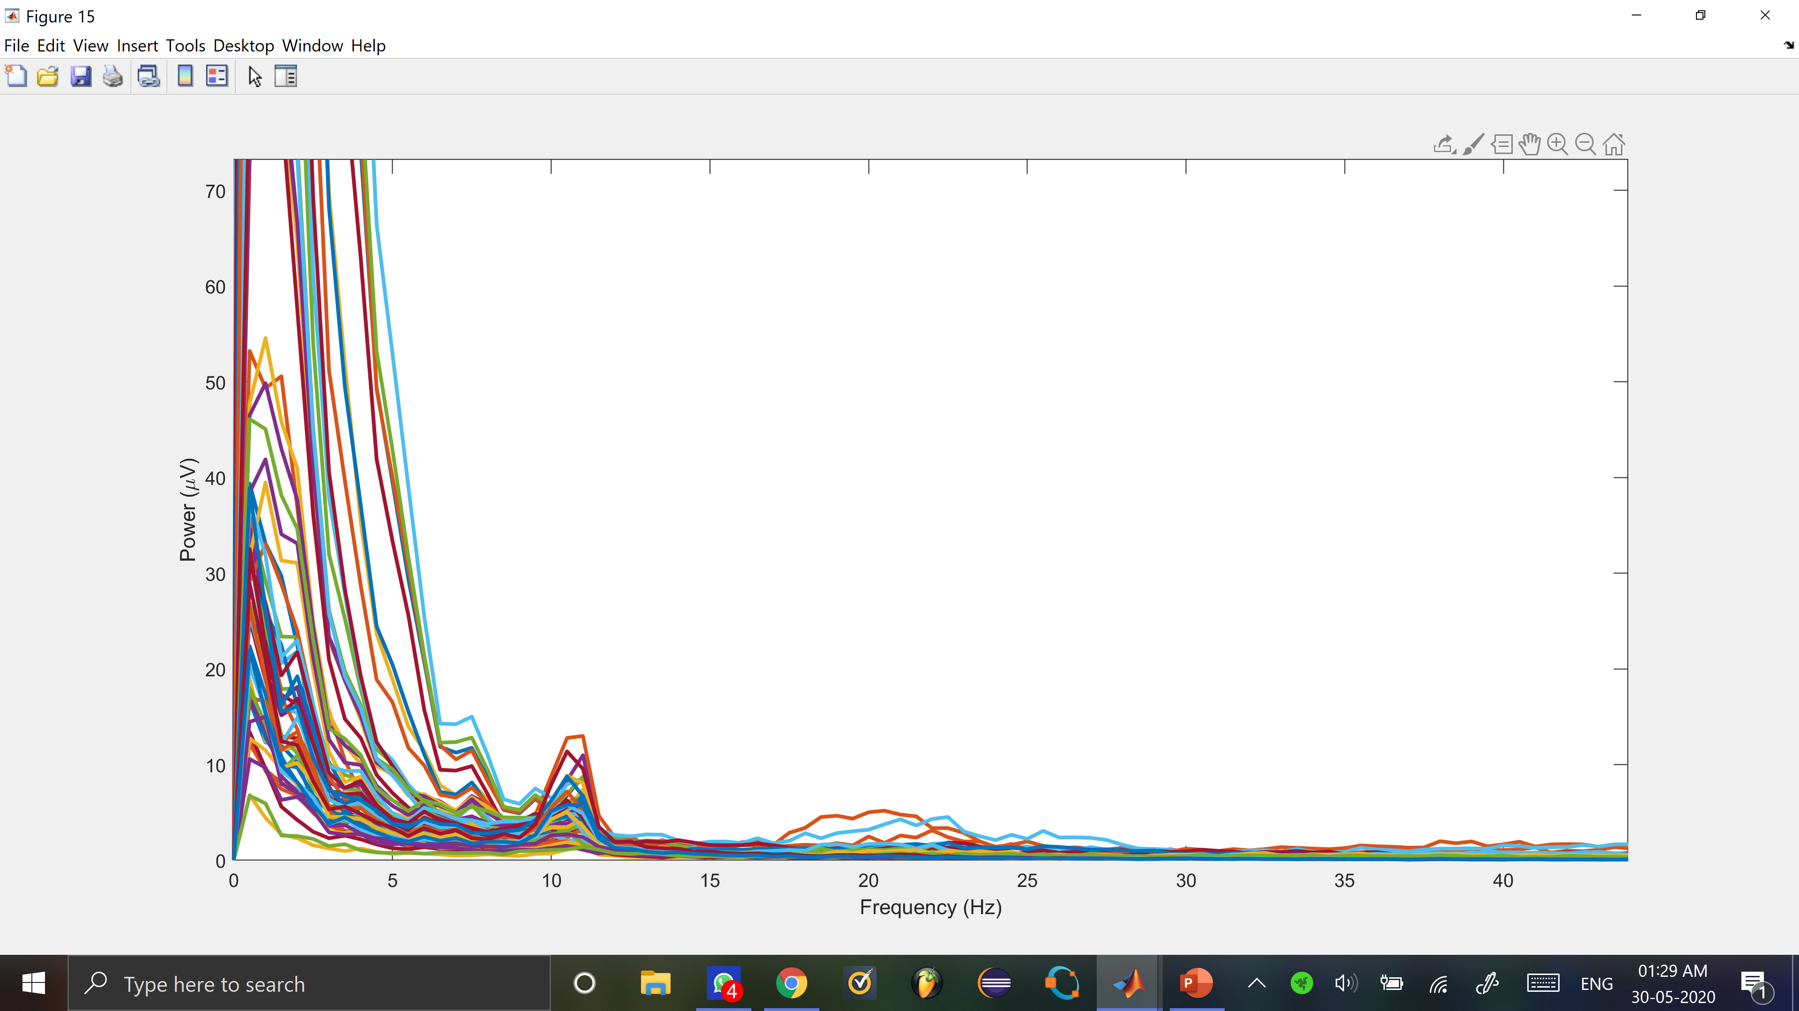

Slide 29
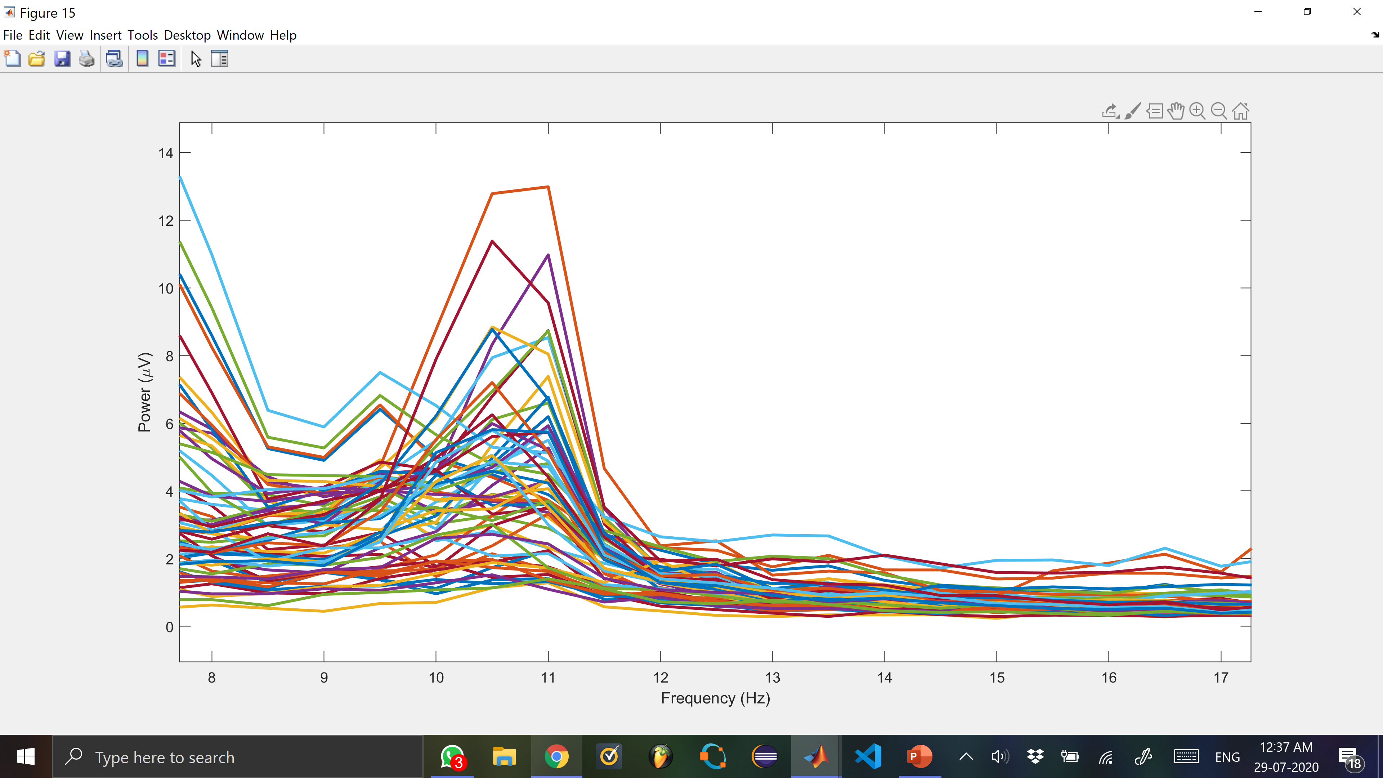

Slide 30
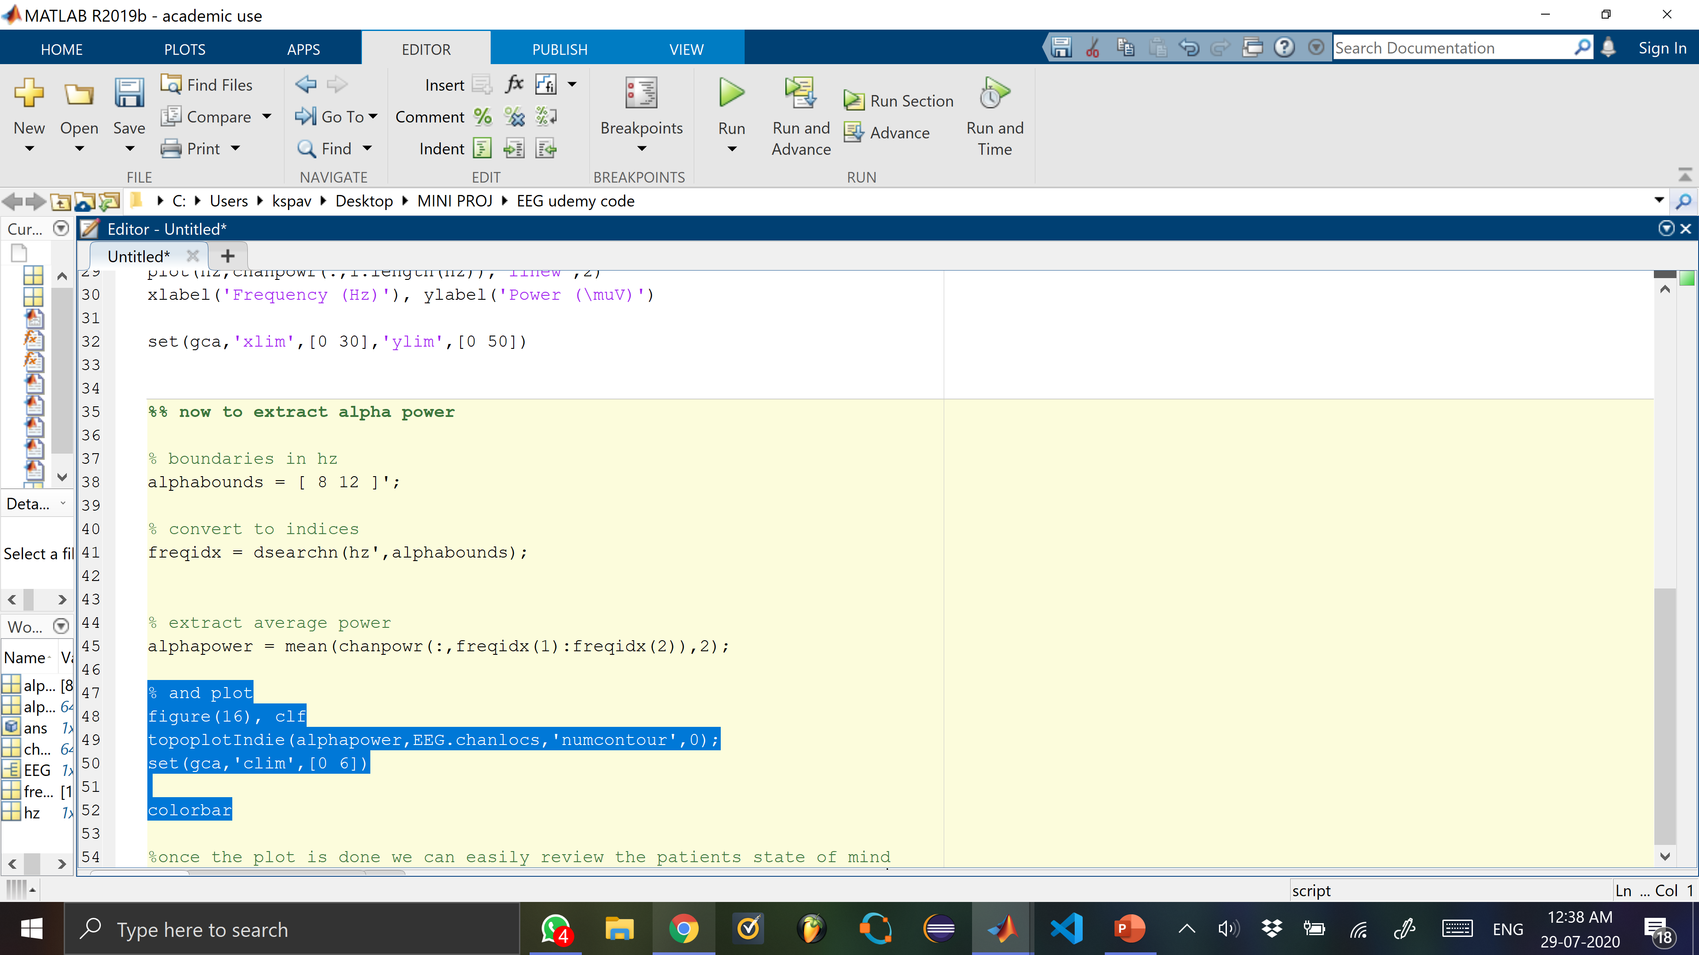
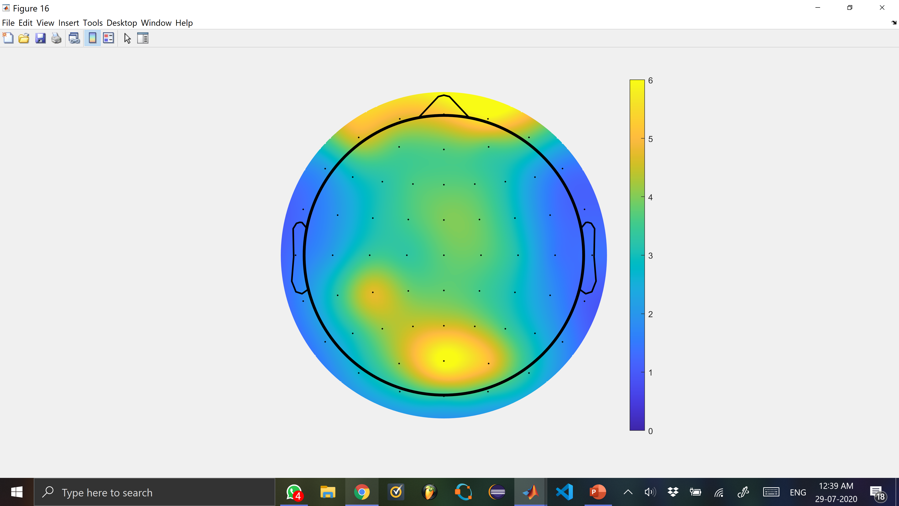
This is with
Colourbar
command

Slide 31
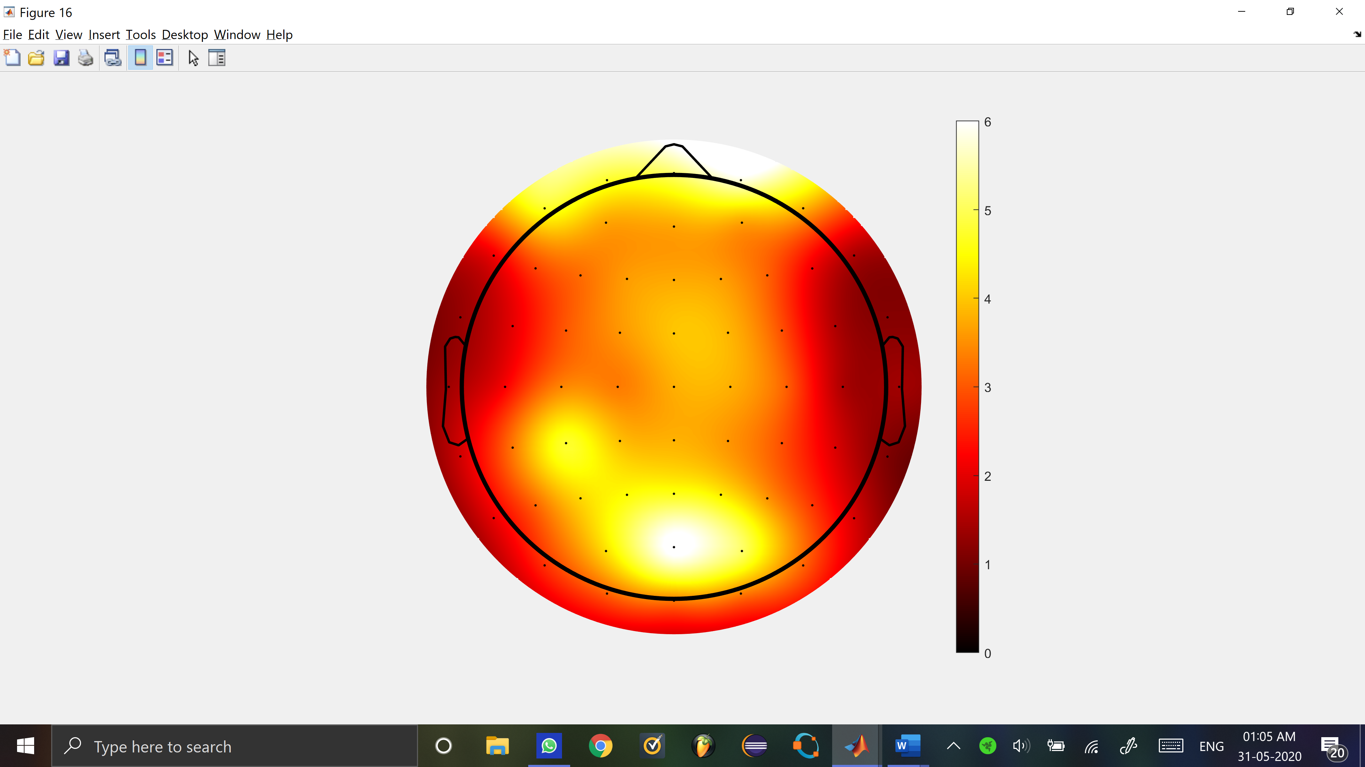
White areas = more alpha power
Excessive Alpha activity is associated with ADHD.
Colourmap hot command

Slide 32
WHY DO WE USE EEG
The greatest advantage of EEG is its temporal resolution. EEG can determine the relative strengths and positions of electrical activity in different brain regions. According to R. Bickford (1987) research and clinical applications of the EEG in humans and animals are used to:
(1) monitor alertness, coma and brain death;
(2) locate areas of damage following head injury, stroke, tumor, etc.;
(3) control anesthesia depth (“servo anesthesia”);
(4) investigate epilepsy and locate seizure origin;
(5) test epilepsy drug effects;
(6) monitor human and animal brain development;
(7) test drugs for convulsive effects;
(8) investigate sleep disorder and physiology.

Slide 33
Conclusion
The EEG method to detect ADHD in children and adults is quite effective and this will help doctors in the medical field to better analyze and understand the nature of this mental illness
As the past 75 years will attest, finding a simple diagnostic measure for ADHD (i.e., behavioral, cognitive, etiologic, neurophysiologic, or neurobiologic) has not been possible and such a measure may not exist at all. Needless to say, we believe that EEG is ready to serve as tools to diagnose or aide in the diagnosis of ADHD.
And we believe this will help the millions of patients out there waiting to be diagnosed with ADHD
This method off EEG detection is nonintrusive,safe and does not involve any medication

Slide 34
Limitations
Findings are limited by the generally small sample size. However, we’d see sample size more critical if findings had not turned out to be significant. Large effect sizes were obtained and effects were not just due to outliers suggesting clear differences in the distribution of control and ADHD groups. In any case, larger samples will have to be studied to see if results are confirmed and to what extend EEG-based subtypes can be found.
We could not compare resting and active EEG conditions directly. Thus, it cannot be excluded that corresponding effect sizes could have also been found in the resting EEG of our sample.
Data cleaning can be less vigorous
No real time analysis of the data
No option view data from multiple platforms like mobile etc

Slide 35
Future Work
This project can further be modified to have limitless potential in the future. For example, if the technology improves the data collection and the analysis can be done by the patient itself
The MATLAB analysis can be implemented into the website to get a seamless experience
Create an mobile application for the same
Get doctors and patients from multiple countries to interact in a forum in a separate tab in the website or the mobile application if created
Create an api for the same so that it can embedded into already existing electrical medical equipment so that reduces the rate of error and simplifies the way to use it

Slide 36
Acknowledgments
We acknowledge support from MSRIT
We would like to thank Lingaraju M sir and Rajshekhar Reddy for their valuable support. We also thank all well wishers from our families and friends for their contribution to our confidence to complete this project.
THANK YOU

Slide 37
THANK YOU

